Slide 1





Car Insurance Claim
Capstone Project
Conducted by:
Sayantan Sarkar

Slide 2




CONTENTS
1
6
Introduction
Insights
2
7
Objective
Data Modelling
3
8
Dataset
Recommendations
4
Tools
5
Data Manipulation Process

Slide 3


INTRODUCTION
Automobiles in todays generation has gradually became the necessity of every family, the car insurance also becomes more and more prosperous for auto insurance companies, to maximize revenue, they must sell corresponding insurance plans to different customers. However, because the types of customers are so diverse and the correlation between the characteristics is not obvious, the use of simple statistics cannot enable insurance companies to make accurate judgments about customers. With the advent of machine learning, more models are available to learn data in depth. Thus, more accurate predictions can be achieved. Therefore I have developed a predictive model that assesses the claim probability for car insurance policies.

Slide 4

Objective
The objective would be to understand the factors that influence claim frequency and severity in the period of six months and enable insurance companies to better assess risk and determine appropriate premiums for policyholders.

Slide 5

DATASET
1
6
1. | Dataset Name | Insurance_data (CSV format)
2. | Data Structure | Observations – 58592
 |  | Features – 43
3. | Target Variable | “is_claim”
4. | Categorical columns | 31
5. | Numerical columns | 11

Slide 6

TOOLS
SMOTE
Minmax Scaler
Chi-Squared Test
LGBMClassifier
SVC
Random Forest
Naïve Bayes
XGBClassifier
Cat Boosting
ANOVA Test
Matplotlib
Pandas

Slide 7

Data Manipulation Process
Data Ingestion
Importing dataset
Exploratory Data Analysis (EDA)
Segregating feature/target variable
Data Pre-processing
Feature Importance of categorical fields using Chi-Square method
Feature Selection/Extraction
Outlier treatment
Drawing out the ROC_AUC curve and selecting the best model with highest accuracy score and maximum area under the curve
Predictive Modelling
Splitting data into train and test
Project Outcomes & Conclusion
Null value treatment
Remove useless columns
Check duplicate data
Visualizing categorical features
Visualizing numerical features
Label Encoding categorical data
Scaling data
Observing correlations of each features
Analysis of correlation of independent features vs dependent features
Feature Importance of numerical fields using ANOVA testing
Balancing dataset using oversampling technique
Fitting the data into the model

Slide 8

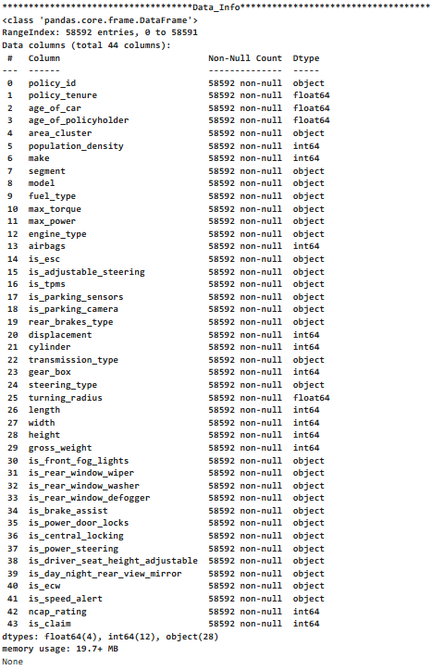
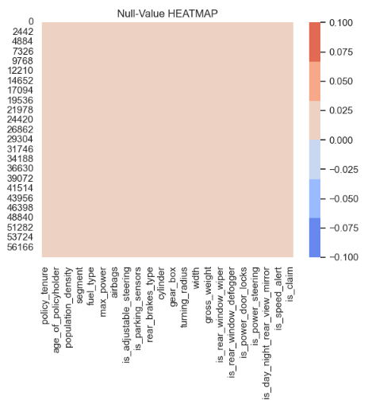
INSIGHTS
Observed no null values all over in the dataset.
Dataset contained 44 columns and 50k+ observations. “Policy ID” was dropped as was unique and unnecessary.

Slide 9
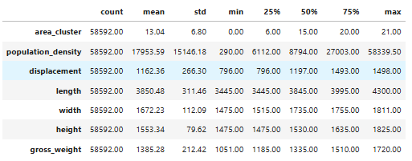
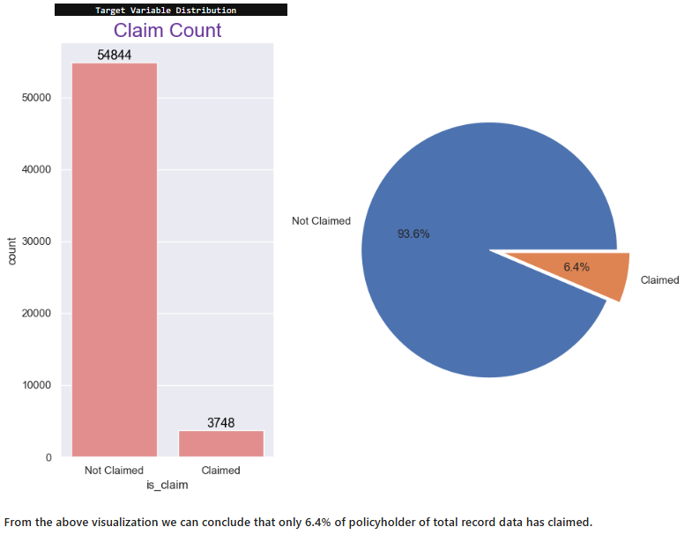
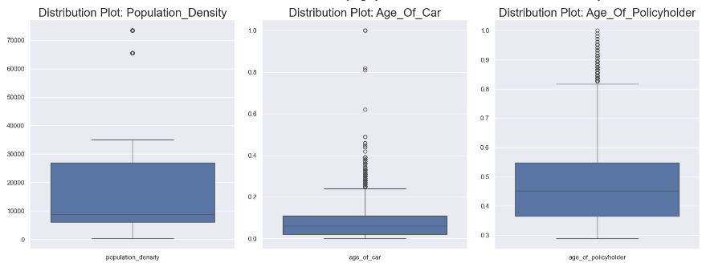
INSIGHTS…
I observed scaling of data was only necessary to few of the features whose mean was high.
My dataset is imbalanced and hence I fixed the same using SMOTE (oversampling) technique.
Distribution plot and box plot shows features 'Population Density', 'Age of Car' and 'Age of policy holder' have outliers.

Slide 10
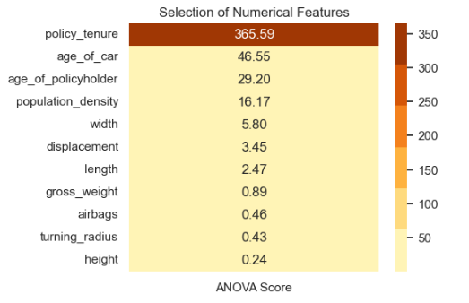
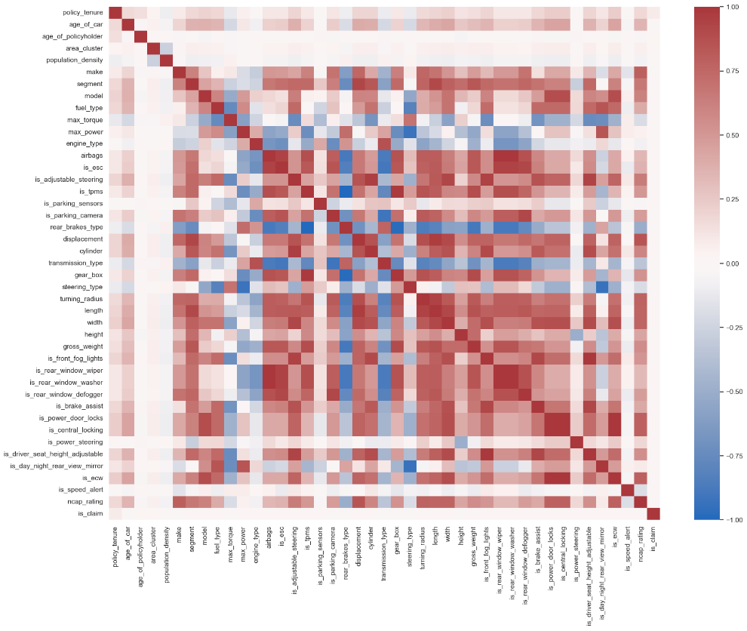
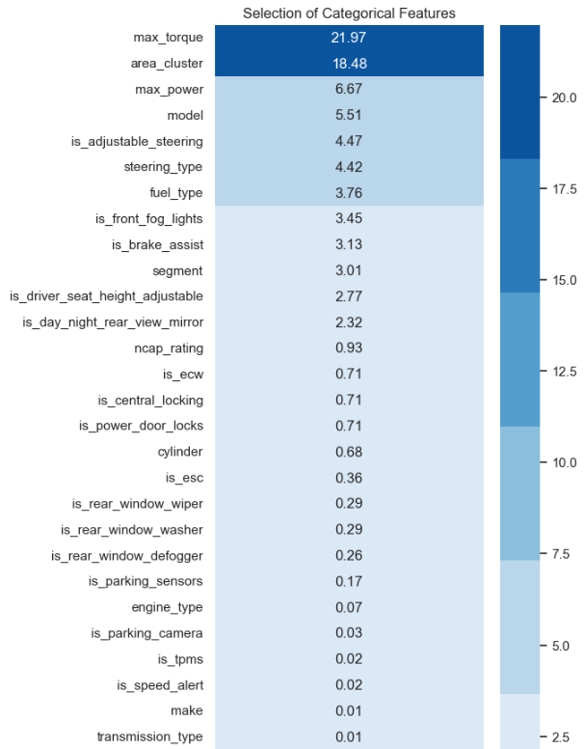
INSIGHTS…
Feature selection of numerical columns using ANOVA test, we can observe that the feature 'policy tenure' is highly impacting the Claims (dependent variable) whereas 'height', 'turning radius', 'airbags' etc. being the least important.
Observed the correlation of each of the features in the dataset using heatmap.
Feature selection of categorical columns using Chi-Square test, I observed that the features ‘max torque' and 'area cluster' is highly impacting the Claims (dependent variable) whereas 'gearbox', 'power steering', 'rear brakes type' etc. being the least important.

Slide 11

DATA MODELLING
Predictive Modelling
5 ML Classifiers
Random Forest Classifier
Accuracy Score – 90% ROC_AUC – 96.24%
XGBoost Classifier
Accuracy Score – 87% ROC_AUC – 93.31%
LightGBM Classifier
Accuracy Score – 92% ROC_AUC – 96.94%
Naive Bayes Classifier
Accuracy Score – 58% ROC_AUC – 59.92%
CatBoost Classifier
Accuracy Score – 93% ROC_AUC – 97.23%
Processed Data
Label Encoding Feature selection/Scaling

Slide 12

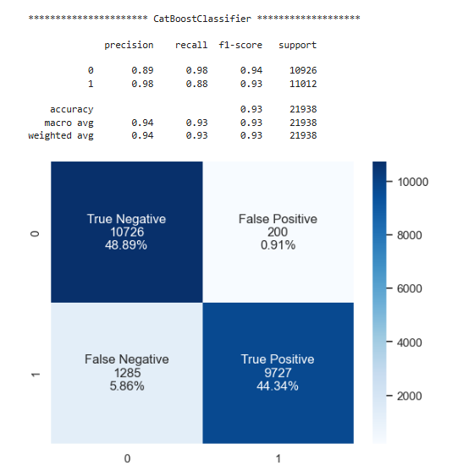
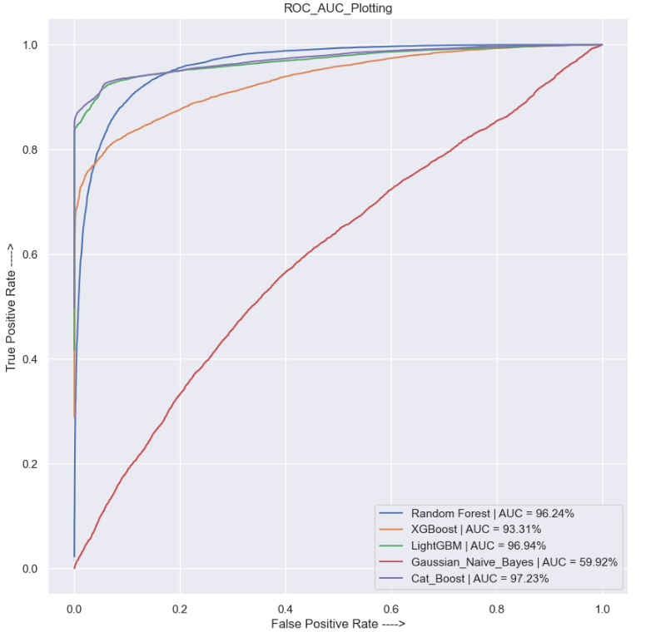
RECOMMENDATIONS
Plotting the Receiver Output Characteristics, Cat Boosting classifier occupied the maximum area under the curve with 97.23%
Out of the 5 ML classifier models Cat Boosting Classifier gave the maximum accuracy score of 93%. Hence I chose Cat Boosting Classifier as the recommended generalized model.

Slide 13

Thank You
GitHub link - Capstone-Projects/Insurance Project at c_projekt · deepsarkar0/Capstone-Projects (github.com)

